Slide 1

MSP Configuration for Control Tower
(Updated as on 18-12-2018)

Slide 2
Purpose
The module will enable –
  Adding Control Tower Maps to MSP
  Adding Control Tower Calendar

Slide 3
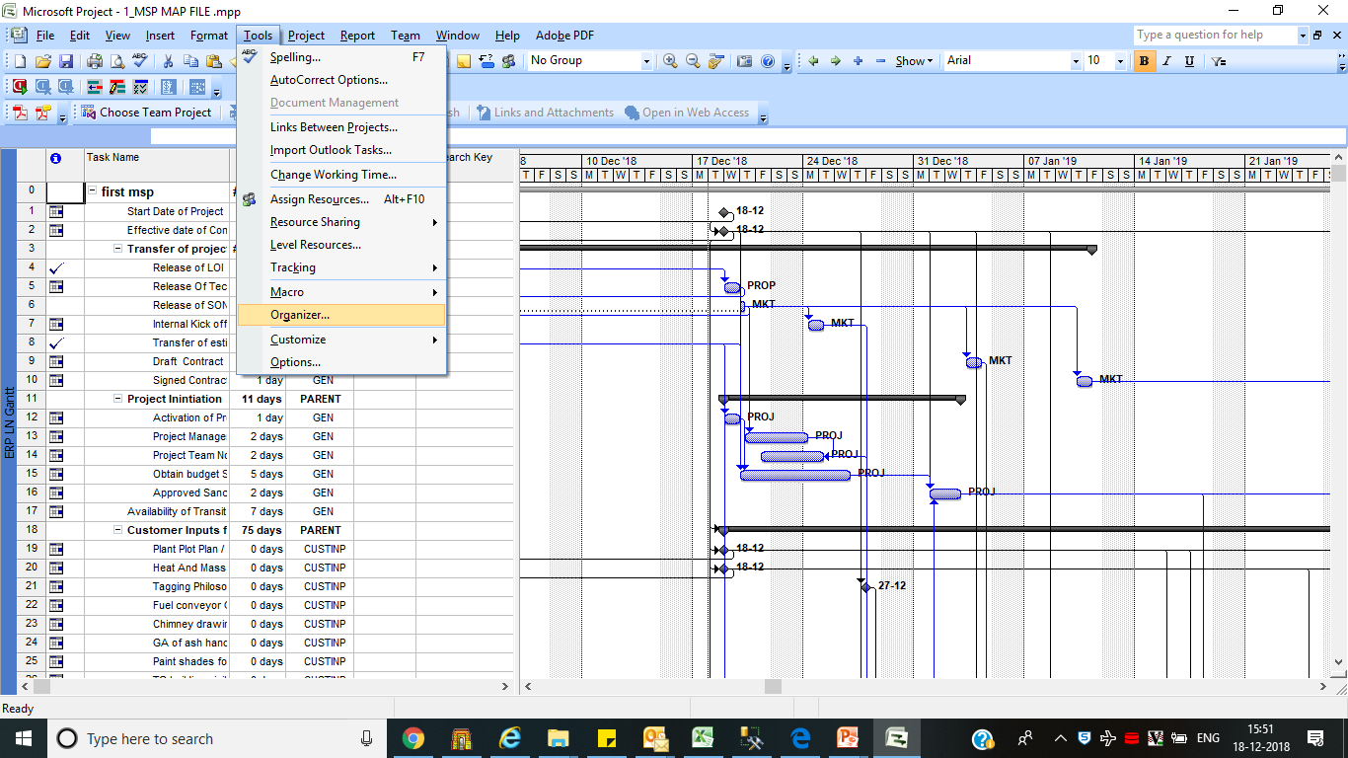
  MSP Configutation
Open File 1_MSP MAP FILE .mpp
Select Tools -- > Organizer

Slide 4
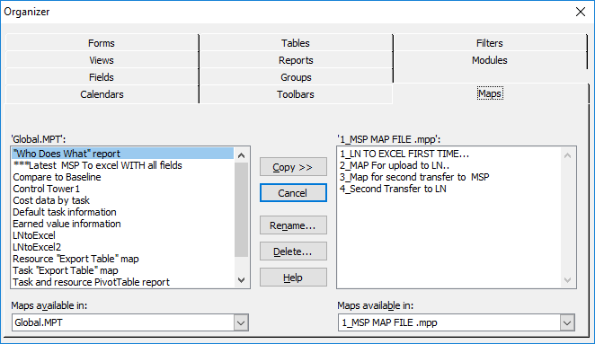
  Adding Maps
Select Maps Tab in dialogue box

Slide 5
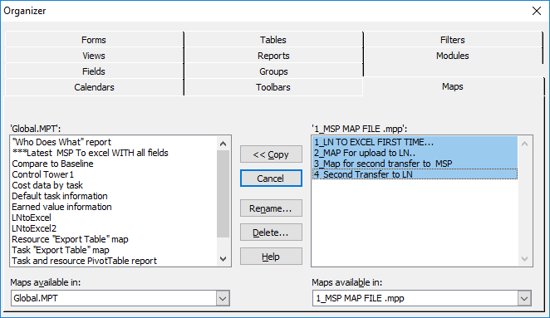
  3. Maintain Manual Outlook Dates-Engineering
Select all 4 Maps in Right side window
Click copy Button

Slide 6
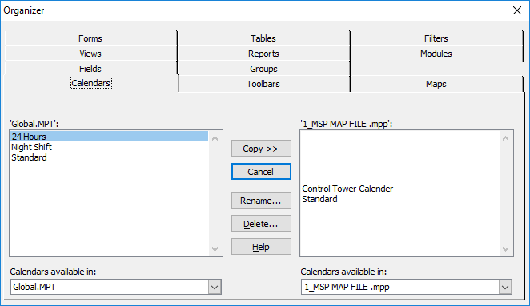
  3. Maintain Manual Outlook Dates-Engineering
Select Calendars TAB

Slide 7
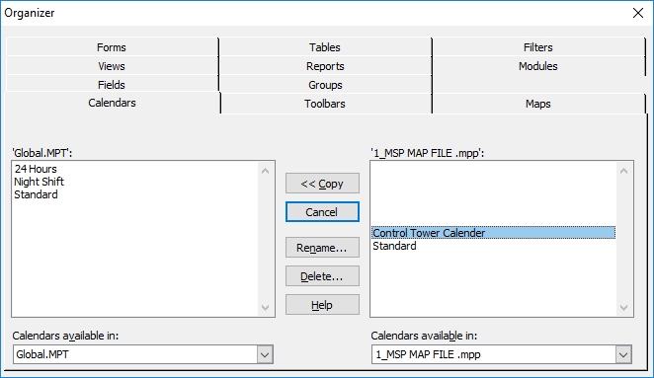
  3. Maintain Manual Outlook Dates-Engineering
Select Control Tower Calendar in right side window and click copy button

Slide 8
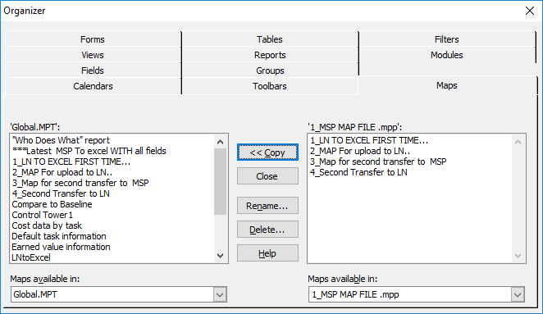
  3. Maintain Manual Outlook Dates-Engineering
Click close button

Slide 9
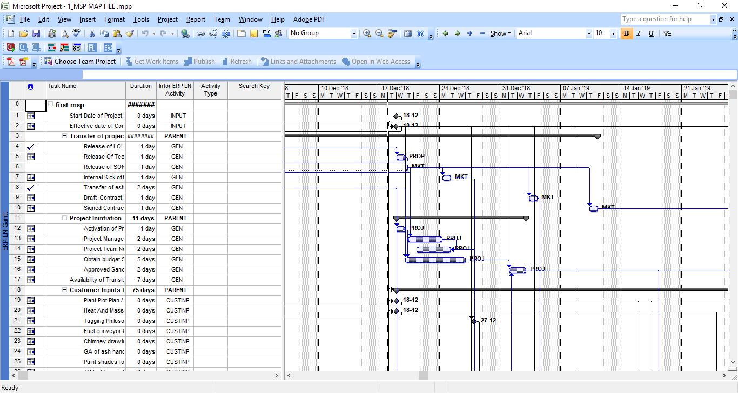
  3. Maintain Manual Outlook Dates-Engineering
Save file and close file

Slide 10
  Check configuration changes
Open File 1_MSP MAP FILE .mpp
Select Tools -- > Organizer
Follow all previous steps(slide 4 to 9) to check that all 4 maps and one calendar is added to MSP on system

Slide 11
End of Document

